Slide 1

PROJECT NAME: ADMISSION PORTAL
UCER
United College of Engineering and research

Slide 2

TRAINING
Submitted by :
Ravi Shankar Pandey
Neel Kamal Mishra
Raju Kushwaha
Submitted to:
Mr. Gaurav narain Singh
(assistant professor)

Slide 3

About Project
It is a type of software which consist
following qualities
It is type Admission Portal which deals with all kind of student details like student id , permanent address , date of birth and many more.
It contains admin login including sign-up for new user to explore the details of student record.
This admission portal is also made connection with DATABASE .
The Program is based on Command User Interface.

Slide 4
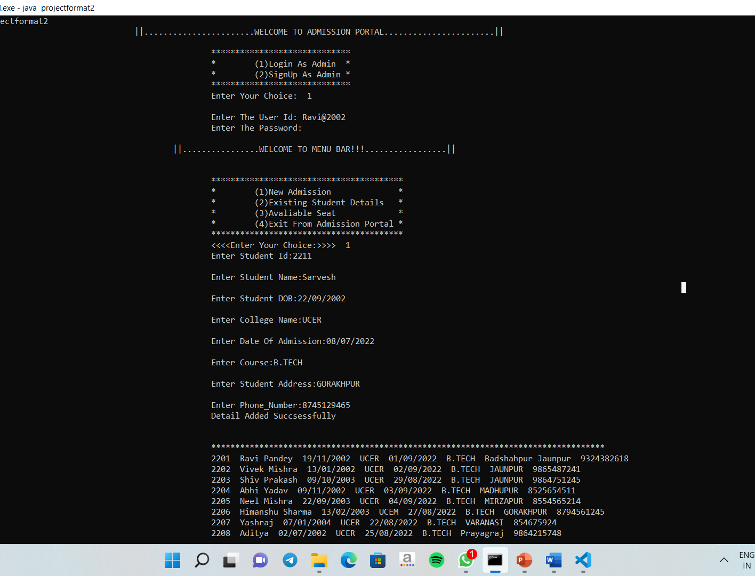
This Slide Contains :
1.Login As Admin
2.SignUp As Admin
3.New Admission
4.Existing Student Details
5.Avaliable Seat

Slide 5
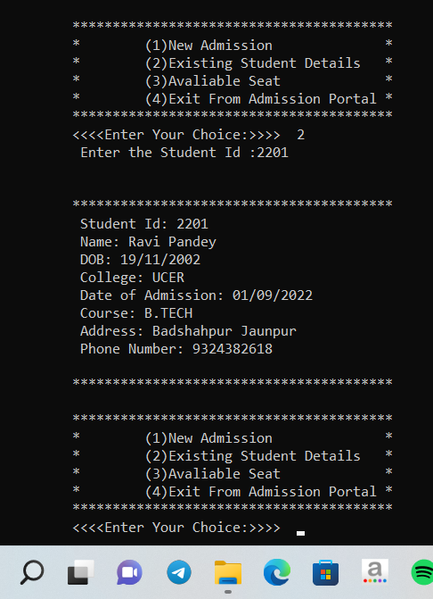
Easy Way To Fetch The Existing Student Detail
After login if any one wants to fetch the data of existing student then by giving input the Student Id , he/she will gets all the information regarding that student….

Slide 6
Element Use In Project
Structured Query Language (SQL) is the set of statements with which all programs and users access data in an Oracle database. Application programs and Oracle tools often allow users access to the database without using SQL directly, but these applications in turn must use SQL when executing the user's request.

Slide 7
Our Upcoming Feature
Addition of More Section
In future it will include the form filling section for the admission of the students.
It is going to include the downloading and accessing feature in future
It is going to attain the feature of providing all the facility of erp and materials for study to the students.

Slide 8

Hardware and Software Requirements
1. Operating system: windows 7/8/10/11. etc.
2. Processor : 1.2 GHz.
3. Memory required : 512 MB.
4. Storage required : 10 MB.
5. Browser :Microsoft edge/chrome etc.
6. Application :Notepad/ Vs code /Oracle
Database etc.

Slide 9


